Slide 1
Gas chromatography - specifically gas-liquid chromatography - involves a sample being vaporized and injected onto the head of the chromatographic column. The sample is transported through the column by the flow of inert, gaseous mobile phase. The column itself contains a liquid stationary phase which is adsorbed onto the surface of an inert solid.
Gas chromatography is a term used to describe the group of analytical separation techniques used to analyze volatile substances in the gas phase. In gas chromatography, the components of a sample are dissolved in a solvent and vaporized in order to separate the analyses by distributing the sample between two phases: a stationary phase and a mobile phase. The mobile phase is a chemically inert gas that serves to carry the molecules of the analyze through the heated column. Gas chromatography is one of the sole forms of chromatography that does not utilize the mobile phase for interacting with the analyze. The stationary phase is either a solid adsorpant, termed gas-solid chromatography (GSC), or a liquid on an inert support, termed gas-liquid chromatography (GLC).

Slide 2
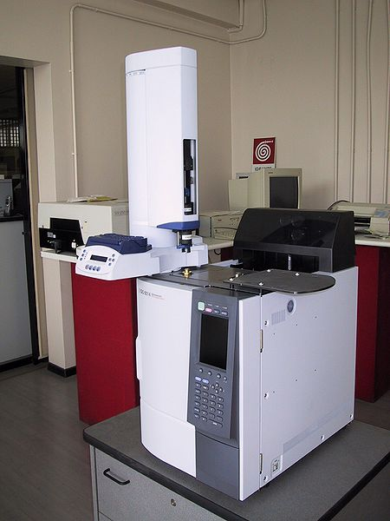
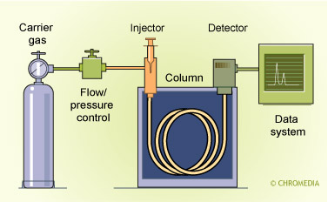
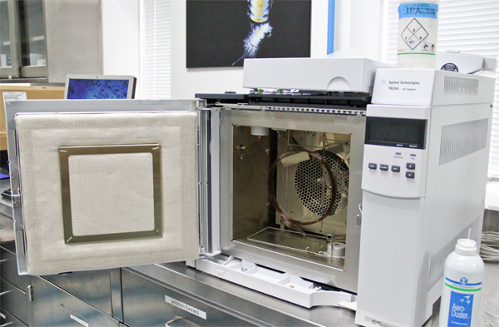

Slide 3
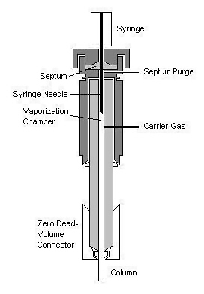
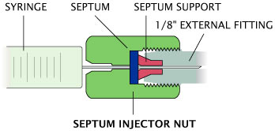
Sample Injection
A sample port is necessary for introducing the sample at the head of the column. Modern injection techniques often employ the use of heated sample ports through which the sample can be injected and vaporized in a near simultaneous fashion. A calibrated microsyringe is used to deliver a sample volume in the range of a few microliters through a rubber septum and into the vaporization chamber. Most separations require only a small fraction of the initial sample volume and a sample splitter is used to direct excess sample to waste. Commercial gas chromatographs often allow for both split and splitless injections when alternating between packed columns and capillary columns. The vaporization chamber is typically heated 50 °C above the lowest boiling point of the sample and subsequently mixed with the carrier gas to transport the sample into the column.

Slide 4
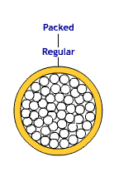
Open Tubular Column( capillary columns) and Packed Columns
There are two general types of column, packed and capillary (also known as open tubular). Packed columns contain a finely divided, inert, solid support material (commonly based on diatomaceous earth) coated with liquid stationary phase. Most packed columns are 1.5 - 10m in length and have an internal diameter of 2 - 4mm.
Capillary columns have an internal diameter of a few tenths of a millimeter. They can be one of two types; wall-coated open tubular (WCOT) or support-coated open tubular (SCOT). Wall-coated columns consist of a capillary tube whose walls are coated with liquid stationary phase. In support-coated columns, the inner wall of the capillary is lined with a thin layer of support material such as diatomaceous earth, onto which the stationary phase has been adsorbed. SCOT columns are generally less efficient than WCOT columns. Both types of capillary column are more efficient than packed columns.
In 1979, a new type of WCOT column was devised - the Fused Silica Open Tubular (FSOT) column;
These have much thinner walls than the glass capillary columns, and are given strength by the polyimide coating. These columns are flexible and can be wound into coils. They have the advantages of physical strength, flexibility and low reactivity.
internal diameters from 1-4 mm.

Slide 5
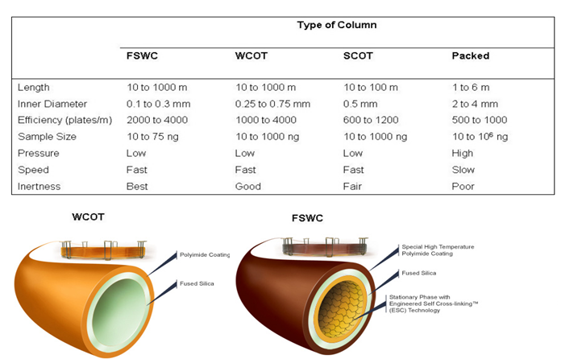
The first is a wall-coated open tubular (WCOT) column
second type is a support-coated open tubular (SCOT) column
One of the most popular types of capillary columns is a special WCOT column called the fused-silica wall-coated (FSWC) open tubular column.

Slide 6
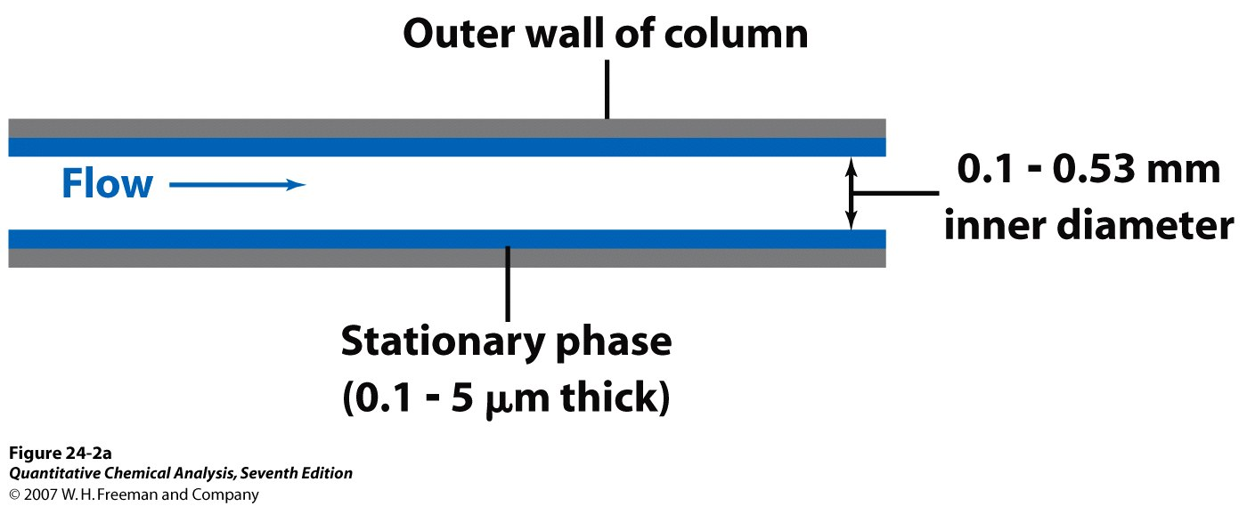
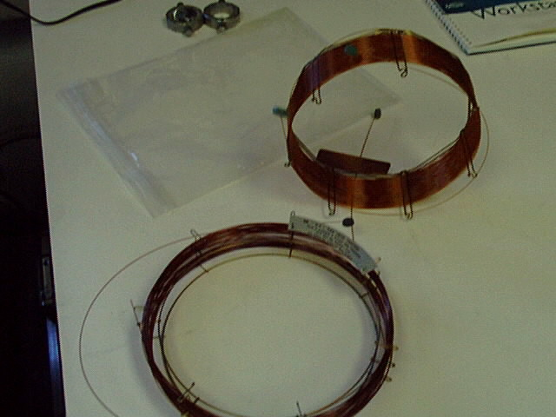
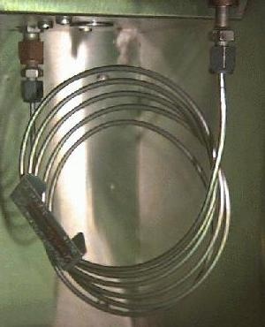
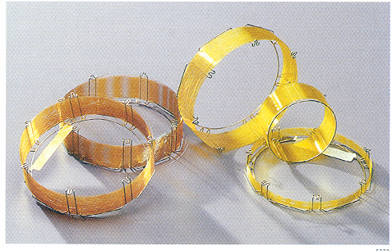
internal diameters from 1-4 mm.

Slide 7
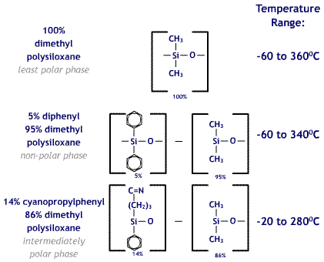

Slide 8
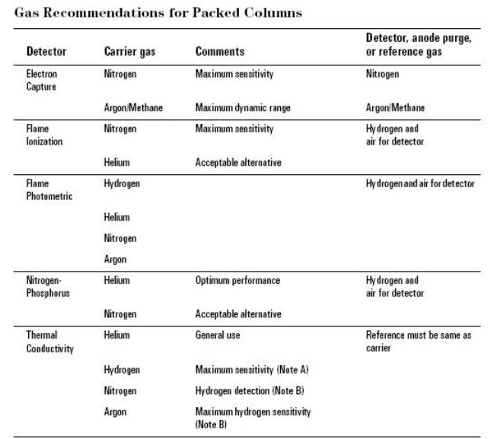

Slide 9
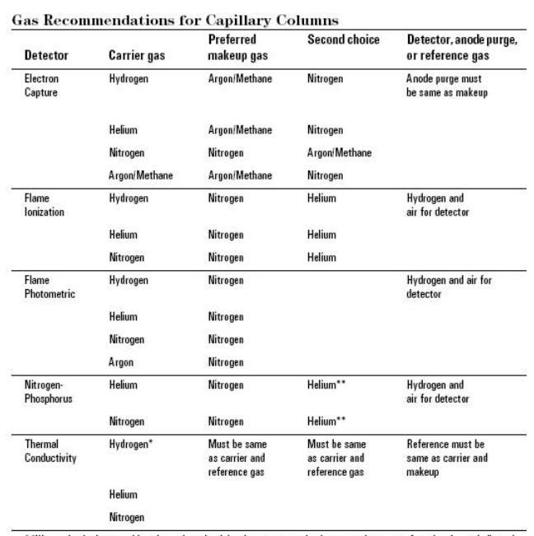

Slide 10
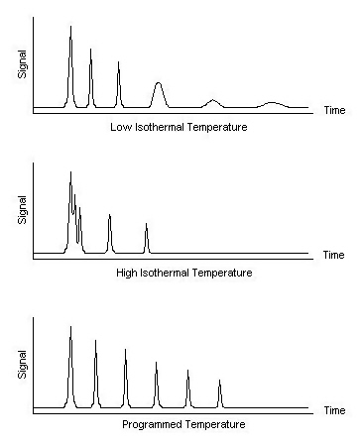
Column Oven
The thermostatted oven serves to control the temperature of the column within a few tenths of a degree to conduct precise work. The oven can be operated in two manners: isothermal programming or temperature programming. In isothermal programming, the temperature of the column is held constant throughout the entire separation. The optimum column temperature for isothermal operation is about the middle point of the boiling range of the sample. However, isothermal programming works best only if the boiling point range of the sample is narrow. If a low isothermal column temperature is used with a wide boiling point range, the low boiling fractions are well resolved but the high boiling fractions are slow to elute with extensive band broadening. If the temperature is increased closer to the boiling points of the higher boiling components, the higher boiling components elute as sharp peaks but the lower boiling components elute so quickly there is no separation.
In the temperature programming method, the column temperature is either increased continuously or in steps as the separation progresses. This method is well suited to separating a mixture with a broad boiling point range. The analysis begins at a low temperature to resolve the low boiling components and increases during the separation to resolve the less volatile, high boiling components of the sample. Rates of 5-7 °C/minute are typical for temperature programming separations.

Slide 11
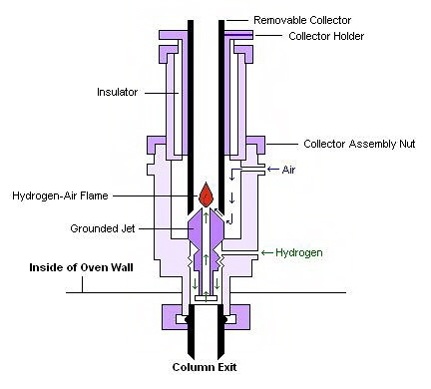
Flame Ionization Detectors
Flame ionization detectors (FID) are the most generally applicable and most widely used detectors. In a FID, the sample is directed at an air-hydrogen flame after exiting the column. At the high temperature of the air-hydrogen flame, the sample undergoes pyrolysis, or chemical decomposition through intense heating. Pyrolized hydrocarbons release ions and electrons that carry current. A high-impedance picoammeter measures this current to monitor the sample's elution.
It is advantageous to used FID because the detector is unaffected by flow rate, noncombustible gases and water. These properties allow FID high sensitivity and low noise. The unit is both reliable and relatively easy to use. However, this technique does require flammable gas and also destroys the sample.

Slide 12
Applications
Gas chromatography is a physical separation method in where volatile mixtures are separated. It can be used in many different fields such as pharmaceuticals, cosmetics and even environmental toxins. Since the samples have to be volatile, human breathe, blood, saliva and other secretions containing large amounts of organic volatiles can be easily analyzed using GC. Knowing the amount of which compound is in a given sample gives a huge advantage in studying the effects of human health and of the environment as well.
Air samples can be analyzed using GC. Most of the time, air quality control units use GC coupled with FID in order to determine the components of a given air sample. Although other detectors are useful as well, FID is the most appropriate because of its sensitivity and resolution and also because it can detect very small molecules as well.

Slide 13
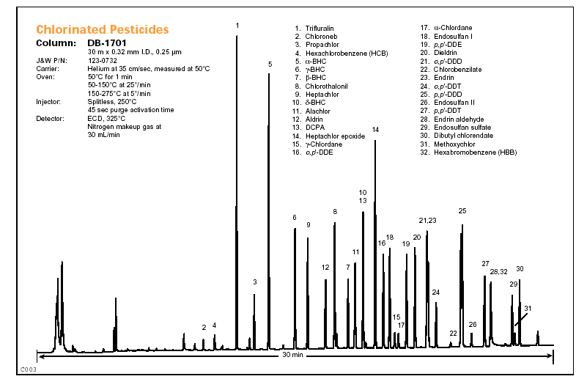

Slide 14
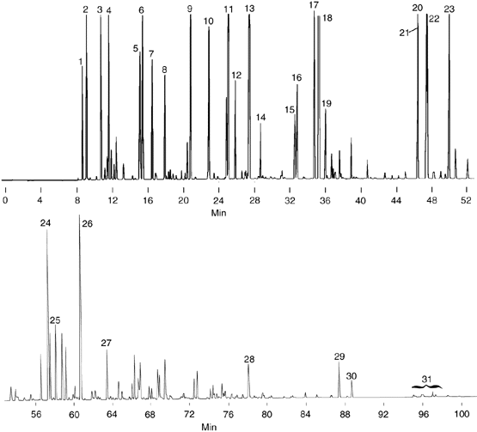
1. Isobutane 2. n-Butane 3. Isopentane 4. n-Pentane 5. 2,3-Dimethylbutane 6. 2-Methylpentane 7. 3-Methylpentane 8. n-Hexane 9. 2,4-Dimethylpentane 10. Benzene 11. 2-Methylhexane 12. 3-Methylhexane 13. 2,2,4-Trimethylpentane 14. n-Heptane 15. 2,5-Dimethylhexane 16. 2,4-Dimethylhexane 17. 2,3,4-Trimethylpentane 18. Toluene 19. 2,3-Dimethylhexane 20. Ethylbenzene 21. m-Xylene 22. p-Xylene 23. o-Xylene

Slide 15
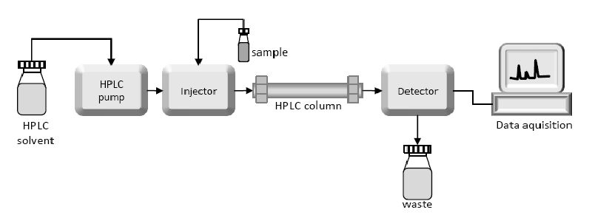
High-performance liquid chromatography
technique in analytical chemistry used to separate, identify, and quantify each component in a mixture. It relies on pumps to pass a pressurized liquid solvent containing the sample mixture through a column filled with a solid adsorbent. Each component in the sample interacts slightly differently with the adsorbent material, causing different flow rates for the different components and leading to the separation of the components as they flow out the column.

Slide 16
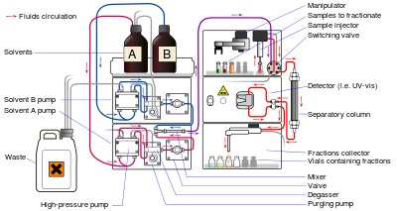

Slide 17
1- Solvent Resorvoir : Mobile phase contents are contained in a glass resorvoir. The mobile phase, or solvent, in HPLC is usually a mixture of polar and non-polar liquid components whose respective concentrations are varied depending on the composition of the sample.
2-Pump : A pump aspirates the mobile phase from the solvent resorvoir and forces it through the system’s column and detector. Depending on a number of factors including column dimensions, particle size of the stationary phase, the flow rate and composition of the mobile phase, operating pressures of up to 42000 kPa (about 6000 psi) can be generated.
3- Sample Injector : The injector can be a single injection or an automated injection system. An injector for an HPLC system should provide injection of the liquid sample within the range of 0.1-100 mL of volume with high reproducibility and under high pressure (up to 4000 psi).

Slide 18
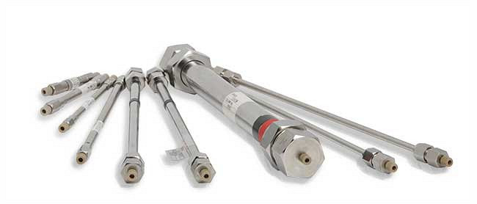
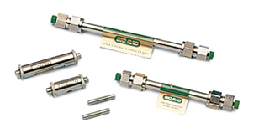
4-Columns : Columns are usually made of polished stainless steel, are between 50 and 300 mm long and have an internal diameter of between 2 and 5 mm. They are commonly filled with a stationary phase with a particle size of 3–10 µm. Columns with internal diameters of less than 2 mm are often referred to as microbore columns. Ideally the temperature of the mobile phase and the column should be kept constant during an analysis.
5-Detector : The HPLC detector, located at the end of the column detect the analytes
as they elute from the chromatographic column. Commonly used detectors are UV-spectroscopy, fluorescence, mass-spectrometric and electrochemical detectors.

Slide 20
Applications of HPLC
Pharmaceutical Applications 1. To control drug stability. 2. Tablet dissolution study of pharmaceutical dosages form. 3. Pharmaceutical quality control.
Environmental Applications 1. Detection of phenolic compounds in drinking water. 2. Bio-monitoring of pollutants.
Applications in Forensics 1. Quantification of drugs in biological samples. 2. Identification of steroids in blood, urine etc. 3. Forensic analysis of textile dyes. 4. Determination of cocaine and other drugs of abuse in blood, urine etc.
Food and Flavour 1. Measurement of Quality of soft drinks and water. 2. Sugar analysis in fruit juices. 3. Analysis of polycyclic compounds in vegetables. 4. Preservative analysis.
Applications in Clinical Tests 1. Urine analysis, antibiotics analysis in blood. 2. Analysis of bilirubin, biliverdin in hepatic disorders. 3. Detection of endogenous Neuropeptides in extracellular fluid of brain etc.

